Slide 1
Mental set
Notes:
hook

Slide 2
24
7
30
Date
Title
EQ –
5
Notes:
Lesson objective (EQ)

Slide 3
Lesson objective
By the end of this lesson you will be able to;
- Calculate the surface area of cylinders & cones
Notes:
Lesson

Slide 4
Success Criteria
You will know you are successful in achieving the objective by…

Slide 5
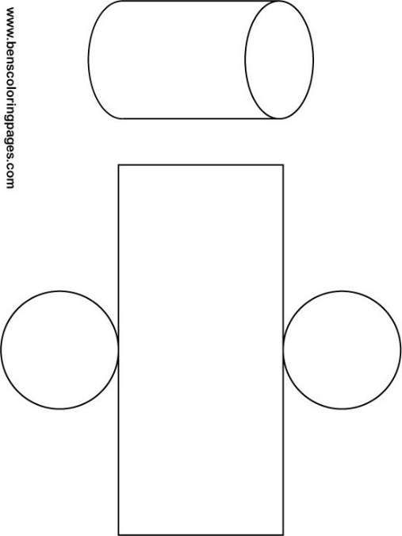

24
7
30
Date
Surface Area - Cylinders
EQ – How do you calculate the surface area of a cylinder
Surface area – Cylinder
For the surface area of a cylinder use the shape net
A cylinder consists of 2 circles and a rectangle. The length of the of this rectangle is the circumference of the circle
SA = 2($πr^{2})+\left(2πr\right)×w$
5
Notes:
Input

Slide 6


Guided Practice
What is the surface area of a can 5cm high and a radius of 3cm
R = 3cm
H = 5cm
SA = $2\left(πr^{2}\right)+((2πr)×h)$
SA = $2\left(π3^{2}\right)+((2π3)×5)$
SA = 169.65+94.25
SA = 264.2 cm²
Notes:
Guided practice

Slide 7
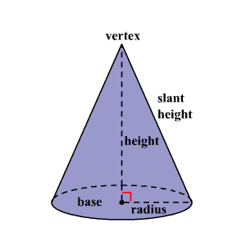

24
7
30
Date
Surface Area - Cone
EQ – How do you find the surface area of a cone
Surface Area – Cone
r = radius
h = height
l = slant height
You need to find the area of the 2 parts of the cone. The circle = 𝝅r²
and the cone.
There are 2 formulas for finding the area of the cone, if you have the slant height the area formula is 𝝅rl.
If you have the height then you use
𝝅r($\sqrt{r^{2}+h^{2}})$
This give 2 formulas
SA₁ = 𝝅r² + 𝝅rl
SA₂ = 𝝅r² + 𝝅r ($\sqrt{r^{2}+h^{2}})$
5
Notes:
Input

Slide 8

Guided Practice
What is the surface area of a cone with a slant height of 8cm and a radius of 5cm
R = 5cm
L = 8cm
SA = 𝝅r² + 𝝅rl
SA = $π5^{2}+π×5×8$
SA = 78.54 + 125.66
SA = 204.20 cm²
Notes:
Guided practice

Slide 9

Guided Practice
What is the surface area of a cone with a height of 7cm and a radius of 5cm
R = 5cm
h = 7cm
SA = 𝝅r² + 𝝅r ($\sqrt{r^{2}+h^{2}})$
SA = $π5^{2}+π×5(\sqrt{5^{2}+7^{2}} )$
SA = 78.54 + $π×5×\sqrt{74}$
SA = 78.54 + 135.09
SA = 213.63 cm²
Notes:
Guided practice

Slide 10
Activity
Nelson Page 172
Q17
Q19 a & b – treat both cylinders as closed at both ends
Page 173 Q26
Notes:
Independent practice

Slide 11
Closure activity
Success Criteria
Thumbs up etc
Notes:
Closure

